Slide 1

CSCI E-59
DESIGNING AND DEVELOPING RELATIONAL AND NOSQL DATABASES
Final Project
Kevin Hill
2023-05-07

Slide 2





Objective
A Data Pipeline (ETL, etc) is only useful if you can guarantee the QUALITY of the resulting data.
To that end this project will explore the application and collection of validation data generated via the Great Expectations Data Quality management framework.
Learning Objectives:
Implementation and configuration of the Great Expectations validation framework
Setup and use of MongoDB for storage of JSON documents
JSON collection aggregation and summarization for reporting
Integration of MongoDB with Spark for downstream processing
great expectations

Slide 3
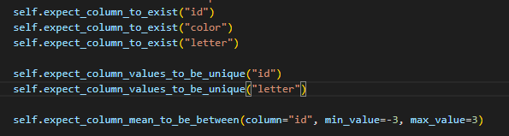
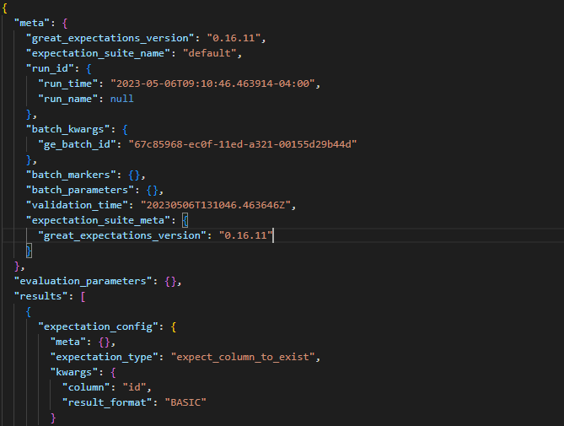
Great Expectations
“Great Expectations provides a framework for validating, documenting, and profiling your data to maintain quality. Software developers have long known that automated testing is essential for managing complex codebases. Great Expectations brings the same discipline, confidence, and acceleration to data science and data engineering teams.”
Defined Expectations:
Resulting Validation (JSON):
https://docs.greatexpectations.io/docs/

Slide 4
Why MongoDB?
Options Analysis:
Spark + HDFS
Fragile - Schema Inference Errors with nested structures
Complex – Less robust JSON query/transform functionality
RDBMS
High Effort – mapping JSON to flattened columns (e.g. kwargs attribute)
Completeness – “throw away” non-mapped data
Maintenance – change management with structure change
NoSQL/Mongo
Native Support – JSON generated documents
Aggregation – First Class JSON transformation support
Integration – Able to provide Spark Read support if needed

Slide 5
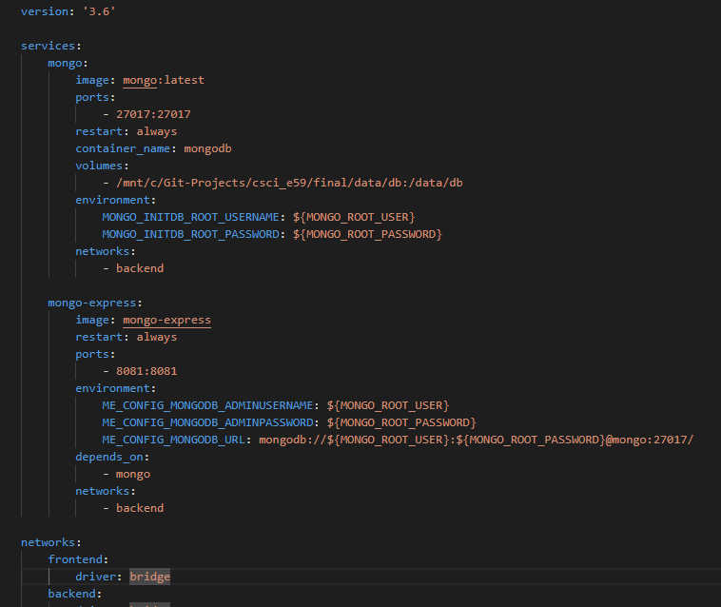
Standing Up MongoDB + Mongo-Express
Docker-compose using:
mongodb (backend)
mongo-express (front-end)
Note: Leveraged local development environment (mongodb://) vs. Atlas Cloud based (mongodb+srv://) offering to learn more about mongo configuration and setup.

Slide 6
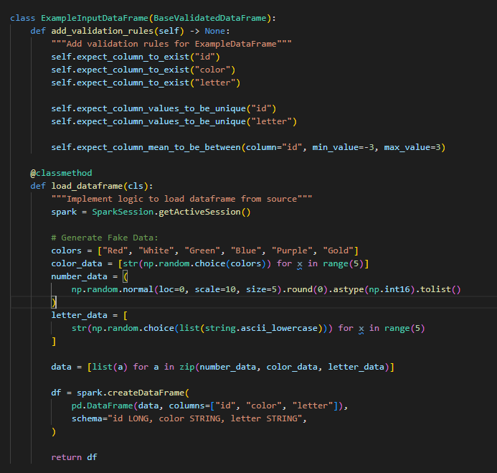
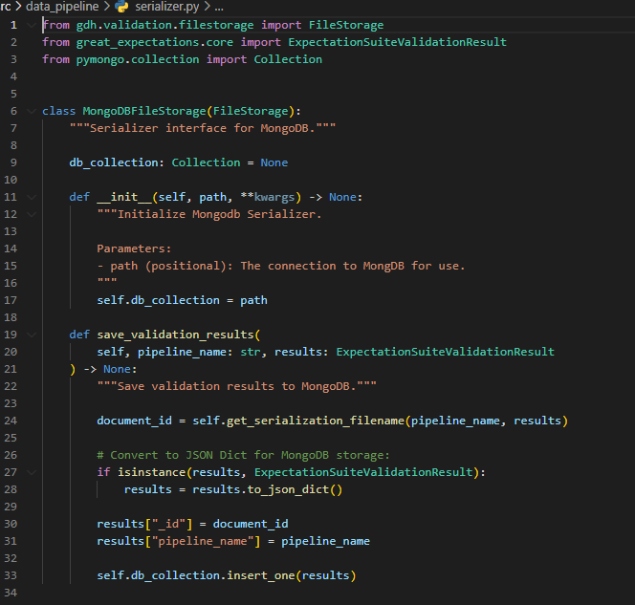
Generating Validation Data
Extend Spark DataFrames to integration validation:
Implement MongoDB Serializer for Validation Results:

Slide 7
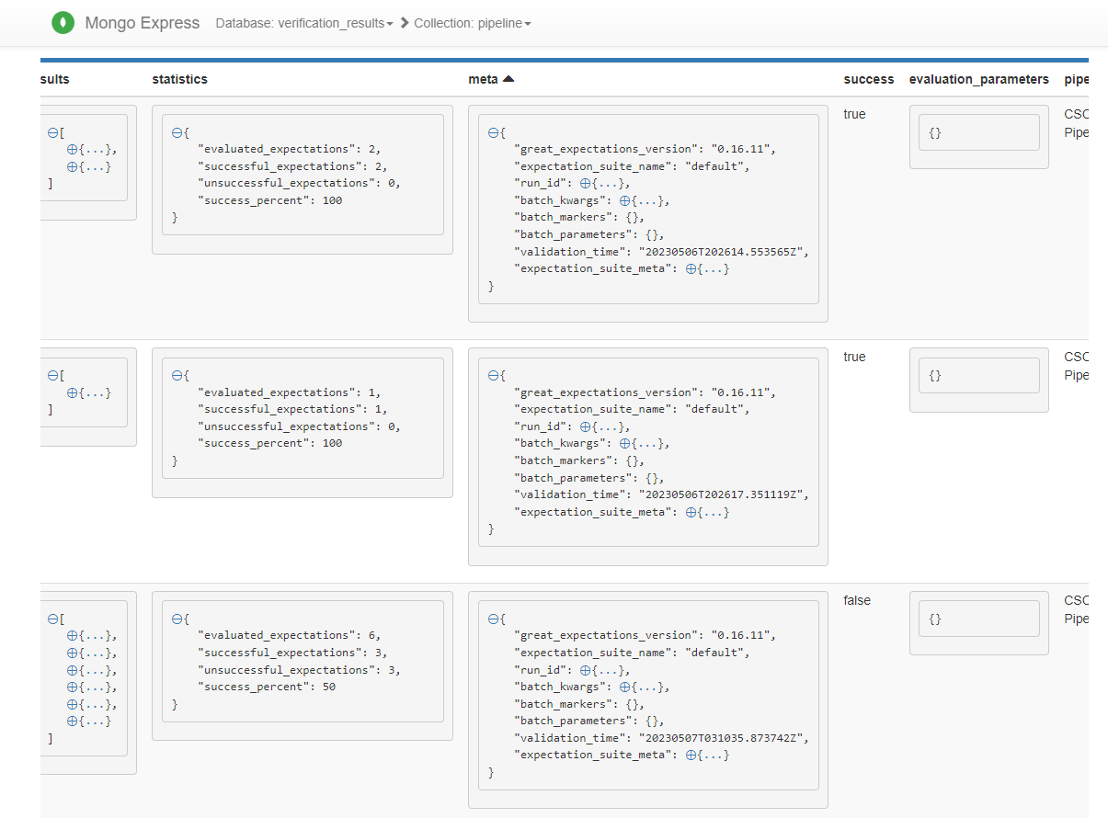
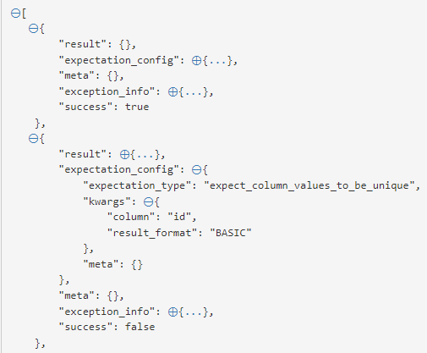
Generating Validation Data
Run pipeline a few thousand times with randomly selected data to create both successful and unsuccessful validation sets (collections of associated expectations).

Slide 8
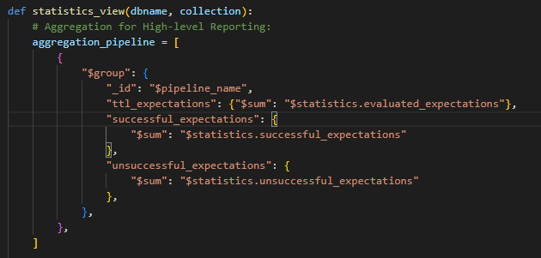
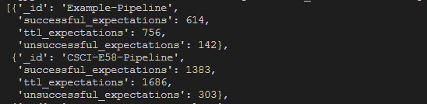
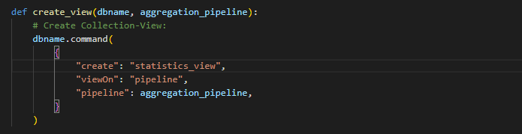
Creating Aggregation Pipelines #1 – Pipeline Summary
Summary Statistics “Standard” View:
Schema Output Definition:
_id | Pipeline name
successful_expectations | Sum of successful expectations for Pipeline name
unsuccessful_expectations | Sum of unsuccessful expectations for Pipeline name
ttl_expectations | Total number of executed expectations (successful + unsuccessful)
Example Pipeline Output:
Note: If additional performance required materialized views could be used instead.

Slide 9
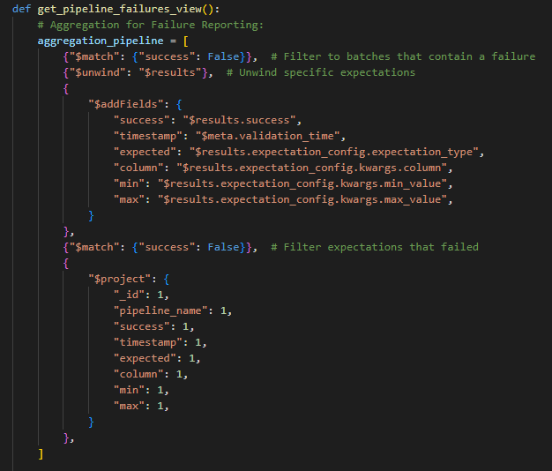
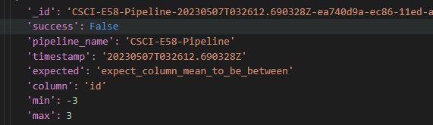
Creating Aggregation Pipelines #2 – Full List of Failed Expectations
Pipeline Failure Reporting:
Schema Output Definition:
_id | Identifier
pipeline_name | Pipeline name
success | Always “False”
timestamp | Timestamp of expectation failure
expected | Expectation that failed
column | Column expectation applied to
min | Min constraint for expectation
max | Max constraint for expectation
Example Pipeline Output:

Slide 10
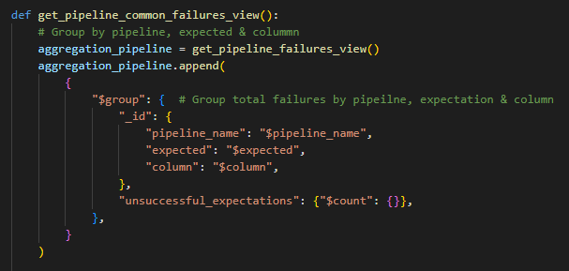
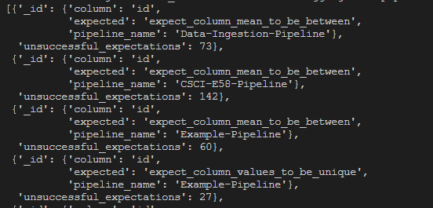
Creating Aggregation Pipelines #3 – Most Common Pipeline / Expectation Failures
Pipeline Failure Reporting:
Schema Output Definition:
_id | Pipeline_name
expected | Expectation that failed
column | Column expectation applied to
unsuccessful_expectations | Total count of failed expectations
Example Pipeline Output:
Note: Builds on previous “pipeline_failures_view”

Slide 11
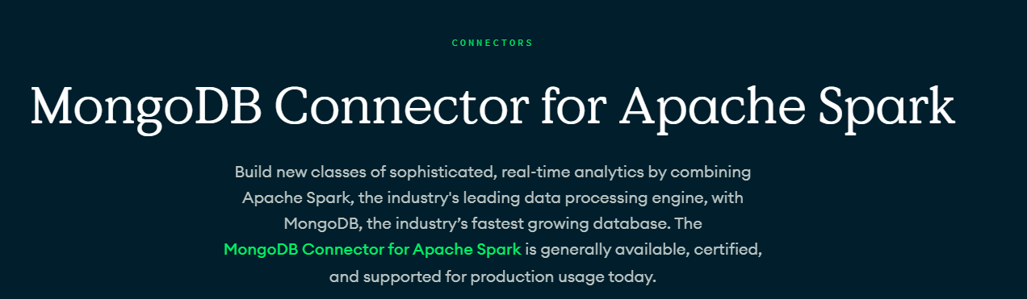
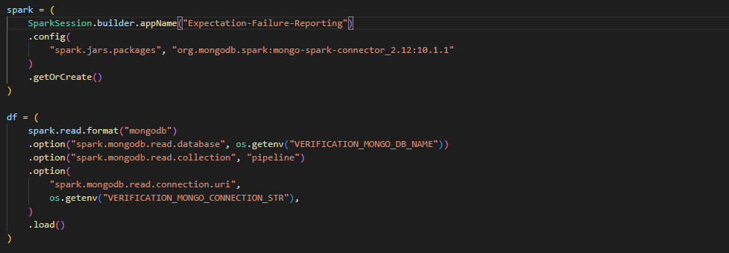
Spark Integration

Slide 12
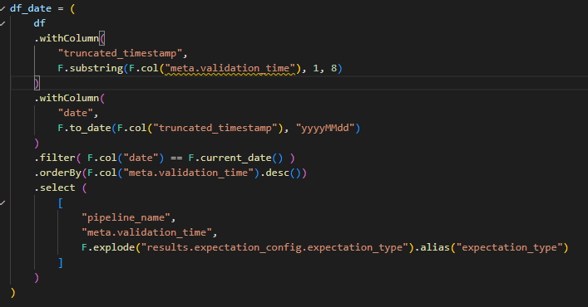
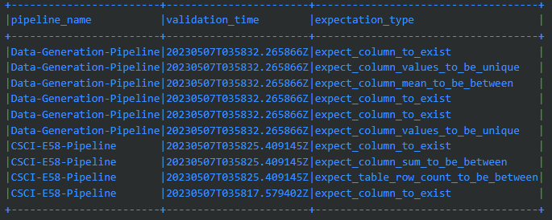
PySpark Query #4 – Today’s Failures
Pipeline Failure Reporting:
Schema Output Definition:
pipeline_name | Pipeline name
validation_time | Timestamp (descending)
expectation_type | Column expectation applied to
Example DataFrame Output:

Slide 13
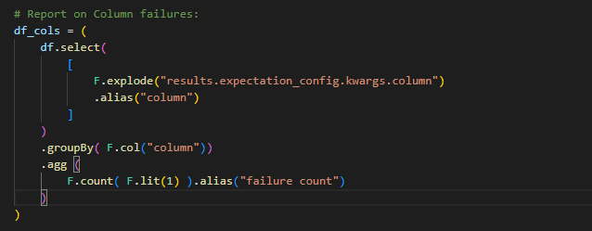
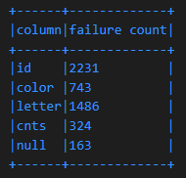
PySpark Query #5 – Column Failures
Pipeline Failure Reporting:
Schema Output Definition:
column | Name of column with failed expectation
failure count | Total number of failures for that specific column
Example DataFrame Output:

Slide 14
Key Design Decisions & Scalability
Design Consideration: Store pipeline validation result documents in separate collections or as part of one collection?
MongoDB provides significant support for filtering, sharding and indexing and limited support for joining across different collections. Given flexibly and desire to report total failures it was decided to store all validation results in one collection.
Design Consideration: Enforce schema validation on collection?
While it is possible to enforce schema validation within a MongoDB collection part of the benefit we are capturing with NoSQL is the ability to have flexible document capture - thus schema validation is not enabled.
Improving Scalability: What indexes can be impact query performance?
Most common fields used in example queries include 1) success and 2) pipeline_name. Building additional collection indexes on these fields can help improve query performance.
Improving Scalability More: What else could we do to improve MongoDB performance at scale?
MongoDB has additional recommended capabilities that would enable us to have robust production support:
Replica Sets – to provide high availability via redundancy of data (critical for always-up SLAs)
Horizontal Sharding – to improve query performance data can be shared over multiple servers. For example, we may look at sharding by “pipeline_name” if many reports will be pipeline specific.

